Slide 1
Java 4 WEB
Lesson 9 – Home tasks overview

Slide 2
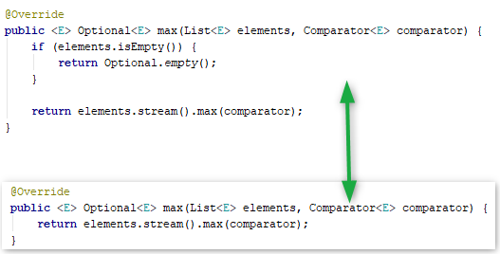
1. Useless code can be removed

Slide 3
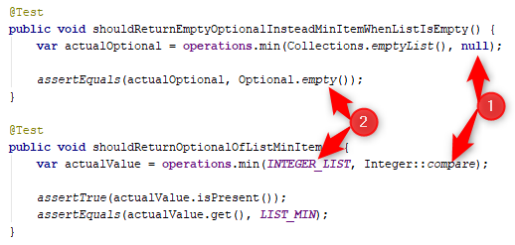
2. Too many different conditions in test

Slide 4
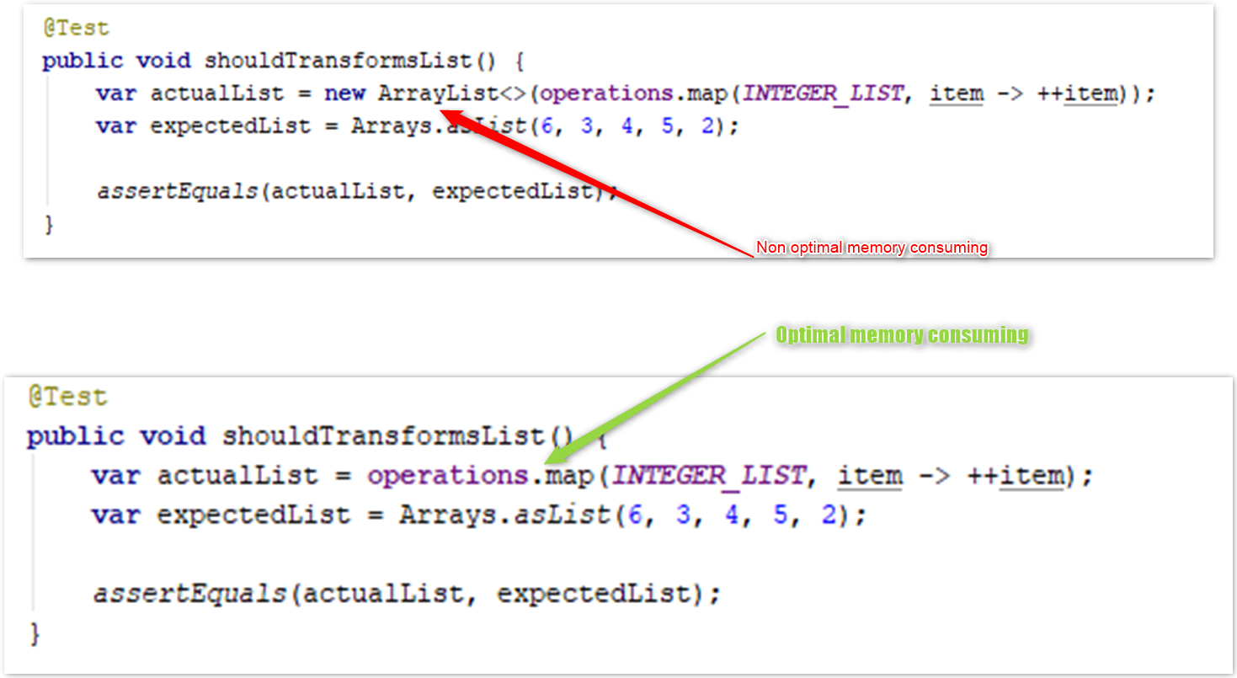
3. Extra containers, non-optimal memory use

Slide 5
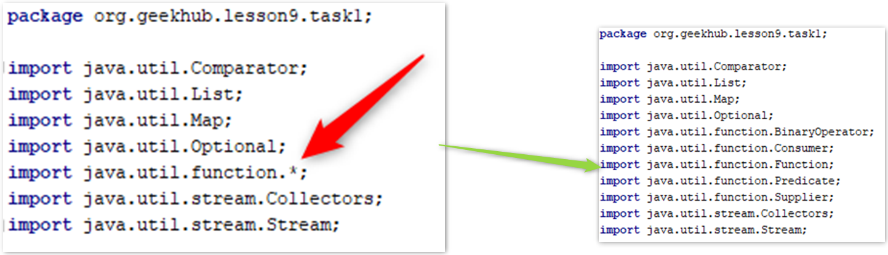
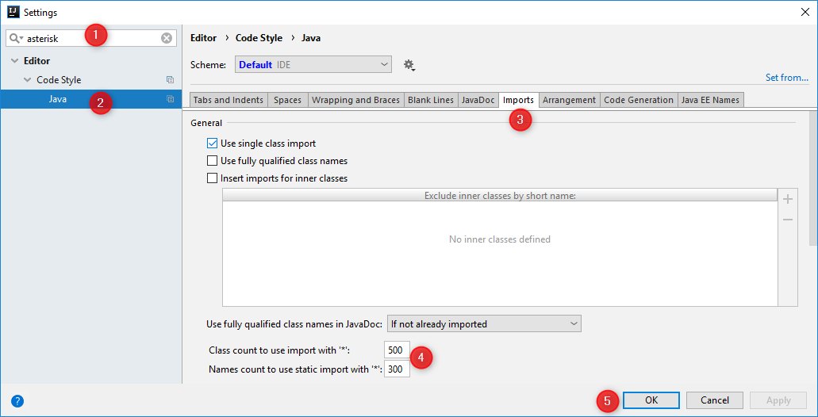
4. Prefer class import but not package import

Slide 6
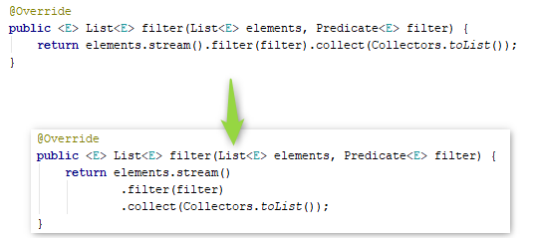
5. Follow ‘Single dot per line’ rule

Slide 7
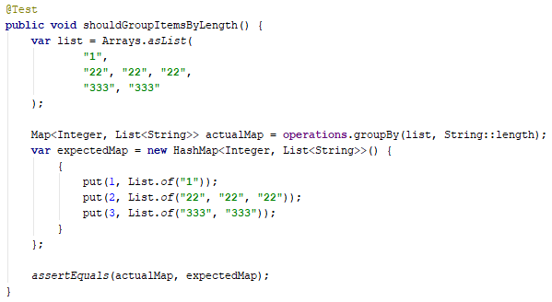
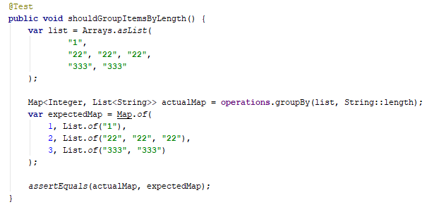
6. Do not use anon class for map initialization

Slide 8
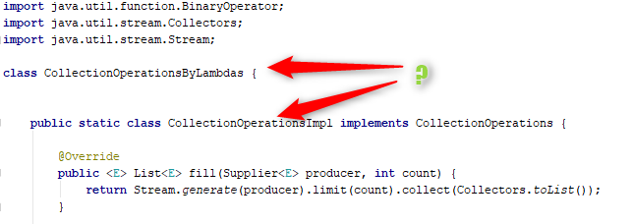
7. Why static classes are needed?
Notes:
Follow Test Driven Development
Copy-Paste

Slide 9
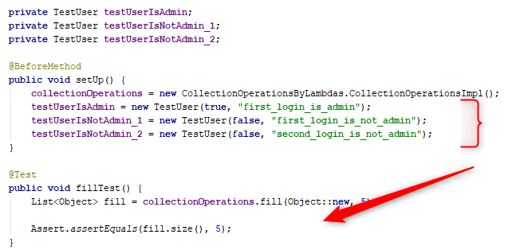
8. Use least needed accessibility scope
Notes:
Follow Test Driven Development

Slide 10
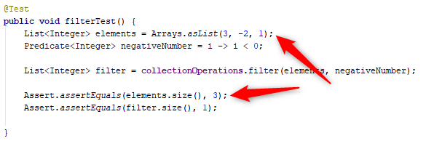
9. Do not test input data
Notes:
Follow Test Driven Development

Slide 11
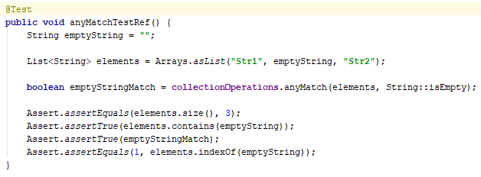
9. Do not test input data - 2
Notes:
Follow Test Driven Development

Slide 12
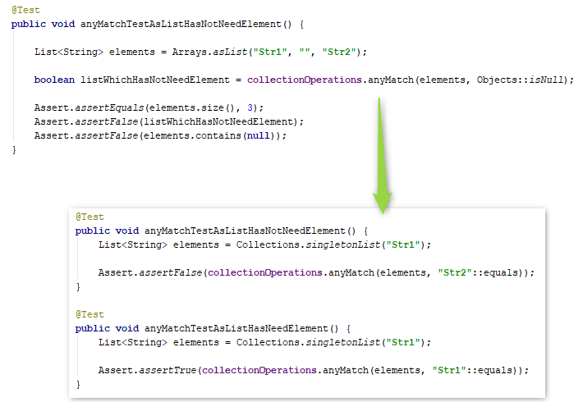
10. Verify both positive and negative results

Slide 13
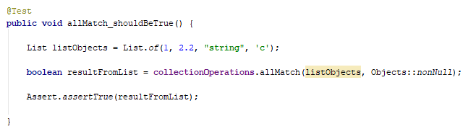
11. Use generics, do not use raw type

Slide 14
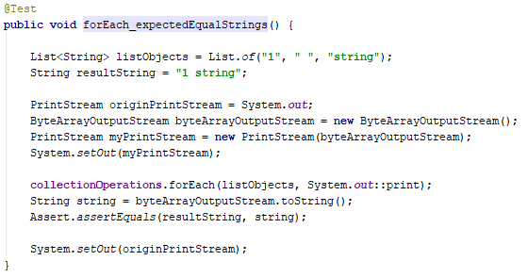
12. Keep It Simple (KISS)
Notes:
Read and follow issues from previous home works
Why `System.setOut()` is needed?

Slide 15
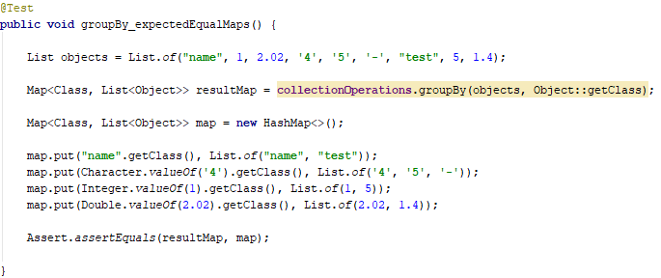
12. Keep It Simple (KISS)

Slide 16
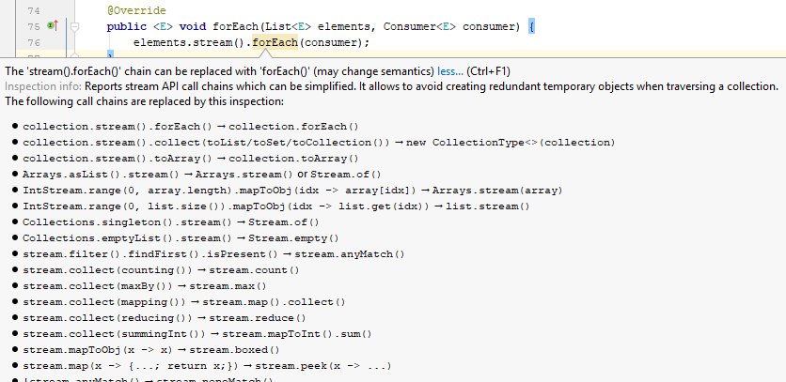
12. Keep It Simple (KISS)

Slide 17
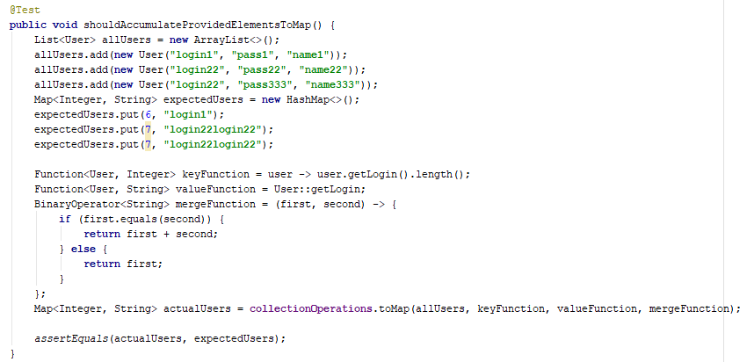
12. Keep It Simple (KISS)
Notes:
Moreover value override is present

Slide 18
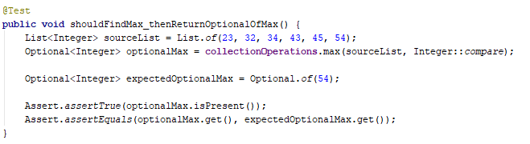
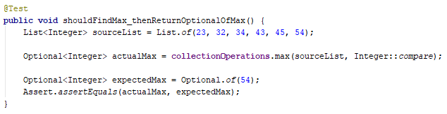
12. Keep It Simple (KISS)
Notes:
Moreover value override is present

Slide 19
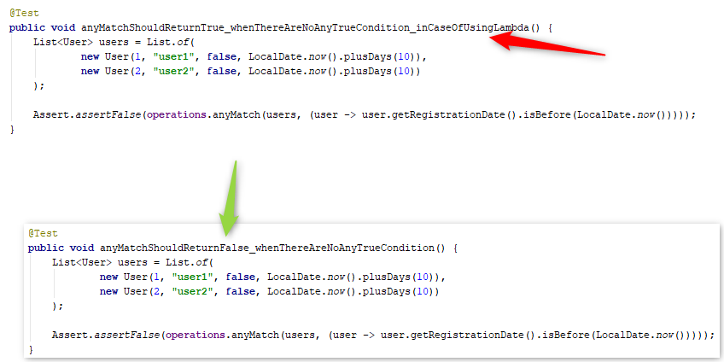
13. Do not copy-paste

Slide 20
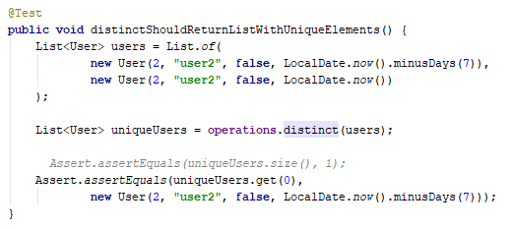
14. Partial validation is not correct validation

Slide 21
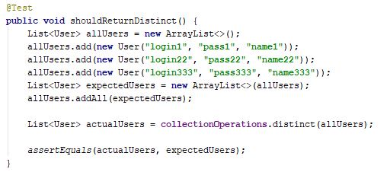
15. Incorrect test data

Slide 22
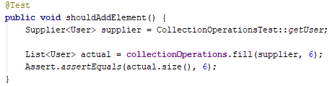
16. Incorrect verification

Slide 23
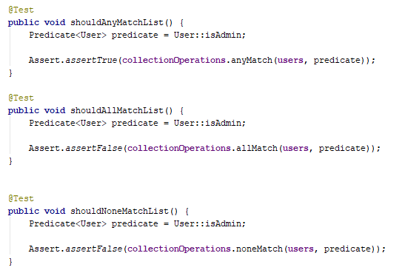
17. Test positive and negative data

Slide 24
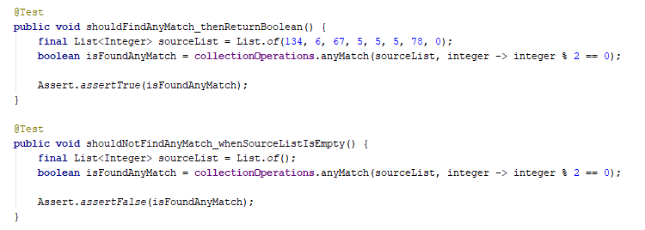
17. Test positive and negative data
Notes:
Missed test for non-empty input with no matched elements

Slide 25
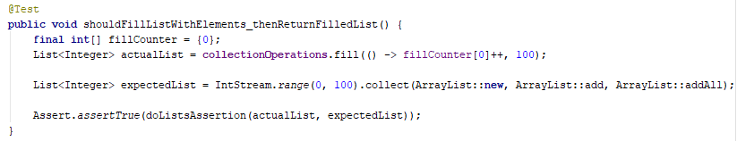
18. Do not write algorithms in tests

Slide 26
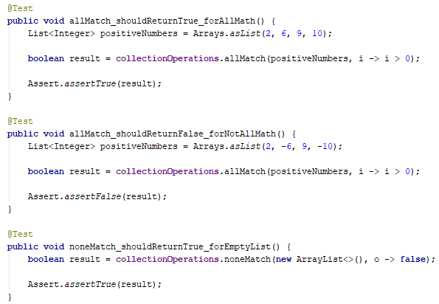
19. Tests should differ only by one condition

Slide 27
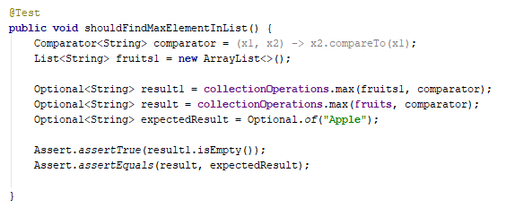
20. Prefer multiple tests but not one complex

Slide 28
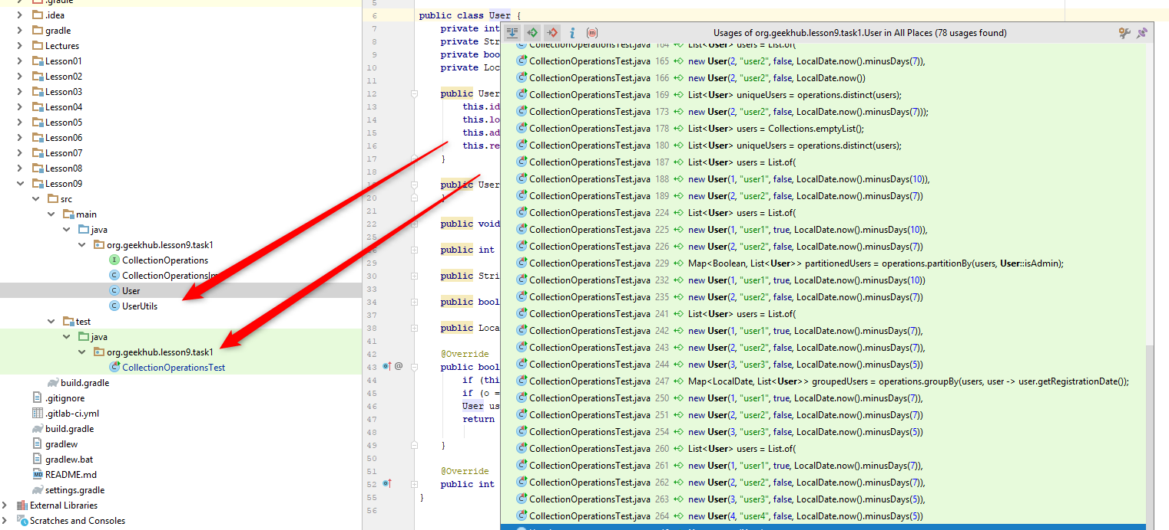
21. Use least needed usage scope

Slide 29
Home task
Read articles about Unit testing best practices
Fix and remember issues from previous home works. Follow recommendations
Apply new knowledge for all code but not only to mentioned in issue
Practice Test-Driven-Development.

